Slide 1
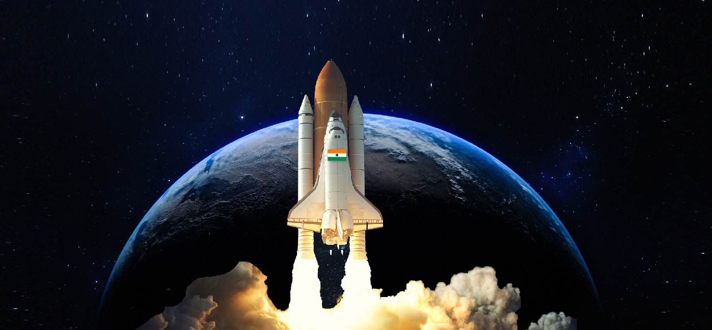
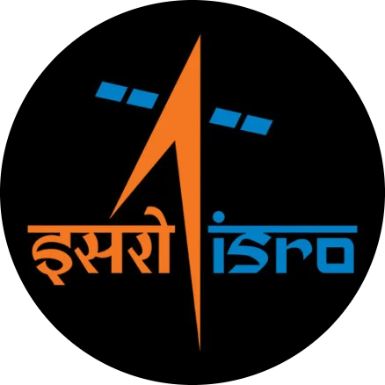
Vision 2047
In Space Science And Technology
TEAM
G. Pavani P. Bindu Ch. Sree Charan

Slide 2










Interplanetary Exploration
Significance
of Vision 2047
Self-reliance
Global leadership
National Security

Slide 3

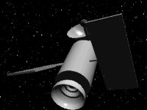


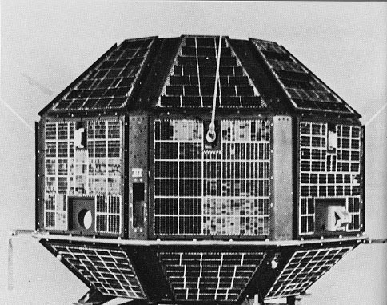
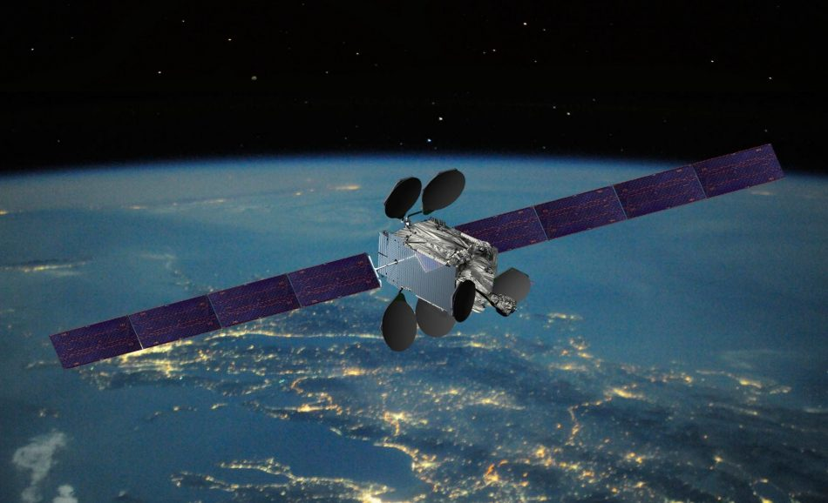
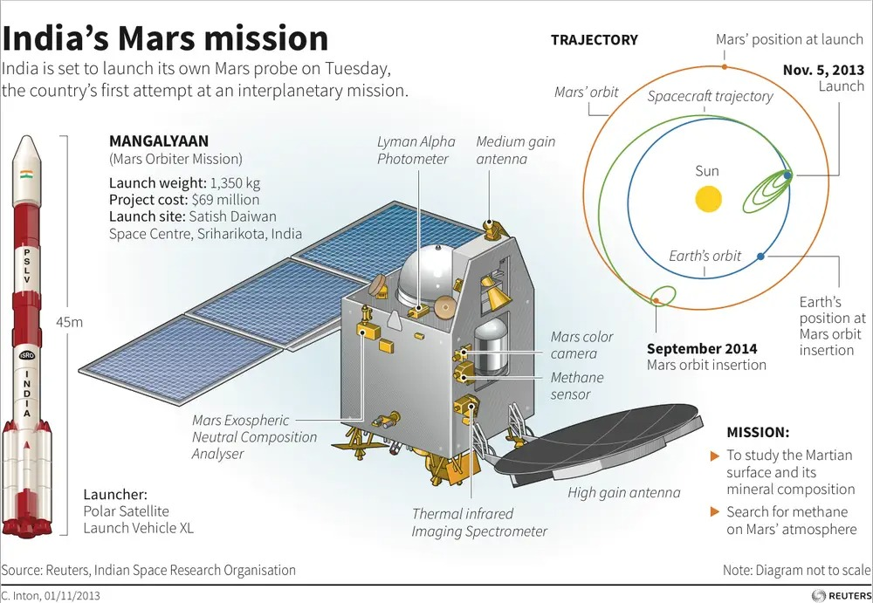
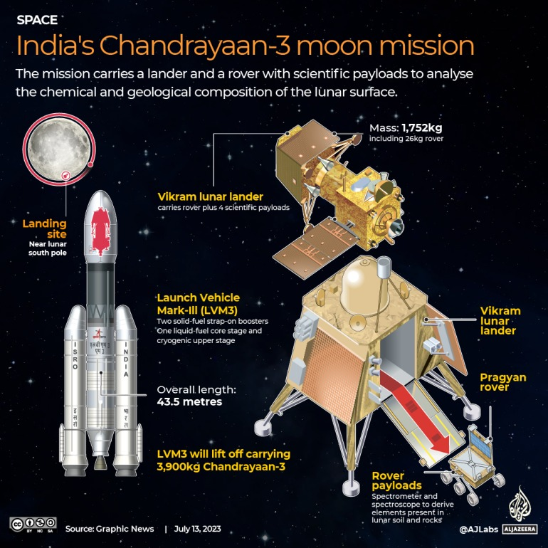
ISRO'S Milestones
There are some of the best milestones of isro
1-Aaryabatta
2 - GSAT-1 Launch
3 - Mangalyaan
4)Chandrayaan-3

Slide 4




Future Goals And Advancements
Advanced Satellite Launches
Quantum communication satellites
Space debris
Space mining and Space Archaeology
Mars missions
Time delay integration sensors

Slide 5

Thank You
From: G. Pavani P. Bindu Ch. Sree Charan

